Slide 2
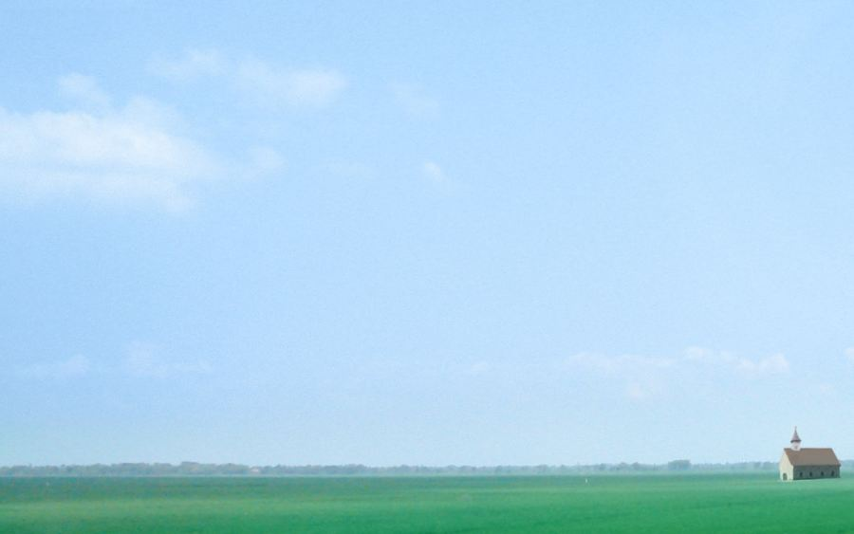
But if we are the body Why aren't His arms reaching? Why aren't His hands healing? Why aren't His words teaching? And if we are the body Why aren't His feet going? Why is His love not showing
them there is a way? There is a way

Slide 5
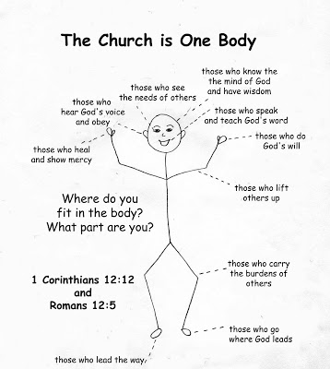

Slide 7
